Slide 1

Hospital Transactions Analysis
Evaluating data to improve healthcare operations
Notes:
AI-generated content may be incorrect. ---

Slide 2

Dataset Overview
Dataset Composition
The dataset contains 230 hospital transactions from early 2021 to mid-2023 with rich operational data.
Financial and Operational Metrics
Includes revenue, expenses, doctor and patient details to analyze hospital financial performance and operations.
Visual Summary Dashboards
Two dashboards summarize key metrics and trends, providing a clear snapshot of hospital operations.
Notes:
The dataset comprises 230 hospital transactions spanning from 2021-01-15 to 2023-08-15. It includes detailed information on doctors, patients, procedures, and financial metrics such as revenue and expenses. The purpose of this analysis is to uncover financial performance trends and operational insights. Two dashboard images are used to visually summarize key metrics and trends, providing a clear snapshot of hospital operations.

Slide 3

Financial and Operational Metrics
Financial Performance Summary
Total revenue reached $274,000 with expenses at $189,000, yielding a profit of $84,140 and a 30.8% profit margin.
Operational Data Overview
Hospital operations include 81 unique doctors and 86 patients, reflecting healthcare service reach and management.
Time Span of Data
Data covers transactions from January 2021 to August 2023, providing a comprehensive multi-year operational view.
Notes:
Key performance indicators derived from the dataset include a total revenue of $274,000, total expenses of $189,000, and a resulting profit of $84,140. The calculated profit margin stands at 30.8%. The dataset covers 81 unique doctors and 86 unique patients. The time range of transactions spans from January 15, 2021, to August 15, 2023, providing a multi-year view of hospital operations.

Slide 4

Operational Challenges
High Operational Expenses
Operational costs are significantly high, especially within specific medical specialties, impacting overall profitability.
Uneven Revenue Distribution
Revenue varies widely across different procedures and specialties, causing inefficiencies in hospital finances.
Lack of Cost Visibility
Limited insight into cost drivers and procedure performance hinders strategic decisions and resource optimization.
Notes:
The analysis identifies several major problems affecting hospital profitability and efficiency. High operational expenses are a significant concern, particularly in certain specialties. Revenue distribution is uneven across procedures and specialties, leading to inefficiencies. Additionally, there is a lack of visibility into cost drivers and procedure-level performance, which hampers strategic decision-making and resource optimization.

Slide 5

Strategic Goals
Enhance Hospital Profitability
Focus on improving profitability by making decisions based on comprehensive financial and operational data analysis.
Identify Top Specialties
Recognize and highlight the best-performing medical specialties and procedures to guide hospital focus and investments.
Optimize Resource Allocation
Allocate hospital resources efficiently to improve operational efficiency and patient care outcomes using data insights.
Notes:
The primary objectives of this analysis are to improve hospital profitability through data-driven decisions, identify top-performing specialties and procedures, and optimize resource allocation. By leveraging insights from financial and operational data, hospital administrators can make informed choices that enhance efficiency and patient care outcomes.

Slide 6

Analytical Targets
Revenue and Expense Trends
Analyze revenue and expense patterns over time to identify financial fluctuations and opportunities.
Profit Margins by Category
Evaluate profit margins across different medical categories to determine areas of high financial performance.
Top Performing Doctors and Procedures
Highlight doctors and procedures contributing most to hospital revenue and patient outcomes.
Strategic Decision Support
Use dashboard visualizations to support informed and strategic management decisions in healthcare.
Notes:
Specific goals of the analysis include examining revenue and expense trends over time, evaluating profit margins by medical category, highlighting top-performing doctors and procedures, and supporting strategic decision-making through dashboard visualizations. These goals aim to provide actionable insights that can guide hospital management in improving financial performance.

Slide 7
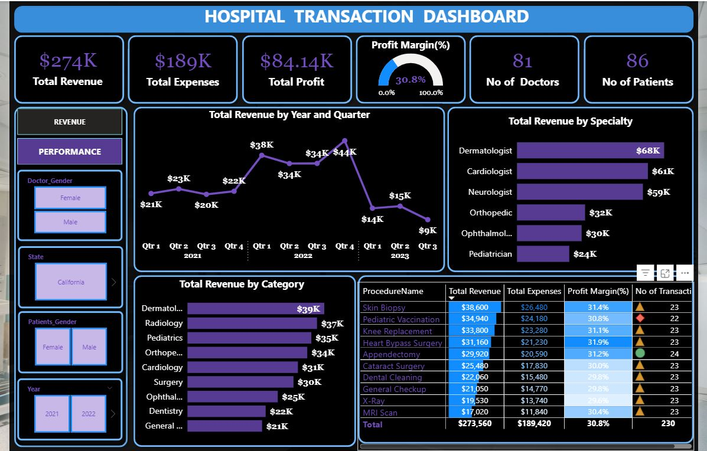
SNAPSHOT OF HOSPITAL TRANSACTION DASHBOARD REVENUE PAGE
Notes:
Dashboard Page 1, Dashboard Page 2

Slide 8
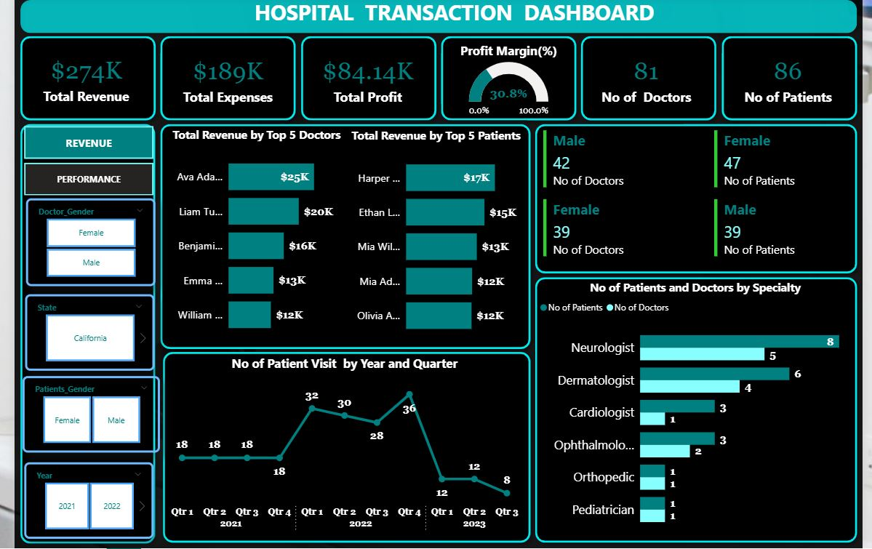
SNAPSHOT OF HOSPITAL TRANSACTION DASHBOARD PERFORMANCE PAGE
Notes:
Dashboard Page 1, Dashboard Page 2

Slide 9

Dashboard Analysis
Revenue Ranking
The dashboard ranks doctors and patients by revenue to highlight financial contributors to the hospital.
Financial Performance Tables
Tables display detailed financial data for top doctors and patients to assess profitability.
Performance Overview
The dashboard highlights key performance indicators including total revenue, expenses, and profit margin for quick insights.
Medical Staff and Patient Counts
Counts of doctors and patients provide an essential metric of healthcare service scope and scale.
Breakdowns by Specialty and Category
Visual charts show financial contributions across different medical specialties and categories for detailed analysis.
Notes:
The first dashboard image provides a performance overview with key performance indicators such as total revenue, expenses, profit margin, and counts of doctors and patients. It includes visual breakdowns by specialty and category, offering a clear view of financial contributions across different medical areas.

Slide 10

Critical Analysis & Insights (Performance Trends)
Top Revenue Specialties
Dermatology, Cardiology, and Neurology lead in revenue generation across medical specialties.
Top Performing Doctors
Certain doctors contribute significantly to revenue, highlighting individual performance excellence.
Seasonal Revenue Trends
Revenue peaks in Q2 and Q4, indicating seasonal fluctuations in healthcare service demand.
Profit Margin Variability
Profit margins vary widely across categories, pointing to areas with improvement potential.
Notes:
The analysis reveals that specialties such as Dermatology, Cardiology, and Neurology generate the highest revenue. Doctors like Ava Adams and Liam Turner are top performers in terms of revenue contribution. Seasonal trends show peak revenue in Q2 and Q4, while profit margins vary significantly across categories. These insights help pinpoint areas of strength and opportunities for improvement.

Slide 11

Recommendations (Strategic Actions)
Focus on High-Margin Procedures
Prioritize procedures like Skin Biopsy and Pediatric Vaccination to maximize profitability and resource utilization.
Reduce Costs in Low-Performing Specialties
Identify and minimize expenses in specialties that underperform to improve overall financial health.
Incentivize Top-Performing Doctors
Reward high-performing medical staff to encourage excellence and better patient outcomes.
Implement Cost Control Measures
Apply effective cost control policies to enhance operational efficiency and profitability.
Notes:
Based on the analysis, several recommendations are proposed: focus on high-margin procedures such as Skin Biopsy and Pediatric Vaccination, reduce costs in low-performing specialties, incentivize top-performing doctors, and implement cost control measures. These actions aim to enhance profitability and operational efficiency.

Slide 12

Summary and Next Steps
Financial and Operational Insights
The analysis highlights top specialties and doctors, cost drivers, and seasonal trends in hospital performance.
Strategic Implementation
Next steps focus on applying recommended strategies to improve hospital operations and financial health.
Continuous Monitoring
Ongoing KPI tracking ensures sustained improvement and effective management of hospital performance.
Notes:
The hospital transactions analysis provides a clear view of financial and operational performance. Key takeaways include identifying top specialties and doctors, understanding cost drivers, and recognizing seasonal trends. Next steps involve implementing the recommended strategies and continuously monitoring KPIs to ensure sustained improvement.

